Slide 1

Creating Workloads with Azure Batch
Alan Smith
Senior Consultant – Active Solution Sweden
@alansmith www.cloudcasts.net

Slide 2
Assessing Processing Requirements
Demo: Analyzing Animation Process Requirements
Azure Batch Client API
Creating Batch Workloads
Demo: Creating Batch Workload using Batch API
Overview

Slide 3
Assessing Processing Requirements

Slide 4


CPU Intensive
Intensive mathematical calculations
Potential for multi-threaded processing
Notes:
Single treaded applications.
Single core machine, single thread,
Can be issues with downloading reference data.
Max Tasks per node can be used, recommended

Slide 5

I/O Intensive
Access to External Resources
Data services
Web services
Read / Write operations
Is caching an option?
Notes:
Copying to and from blob storage
IO to storage is built in, other data sources needs to be custom.

Slide 6

Memory Intensive
Large data volume for task processing
Caching data locally to reduce I/O operations
Notes:
Process starts on VM start and loads the data, task process can call the local cache process.

Slide 7
Task Dependencies
Are any tasks dependent on other tasks?
How much parallelism can be used?

Slide 8
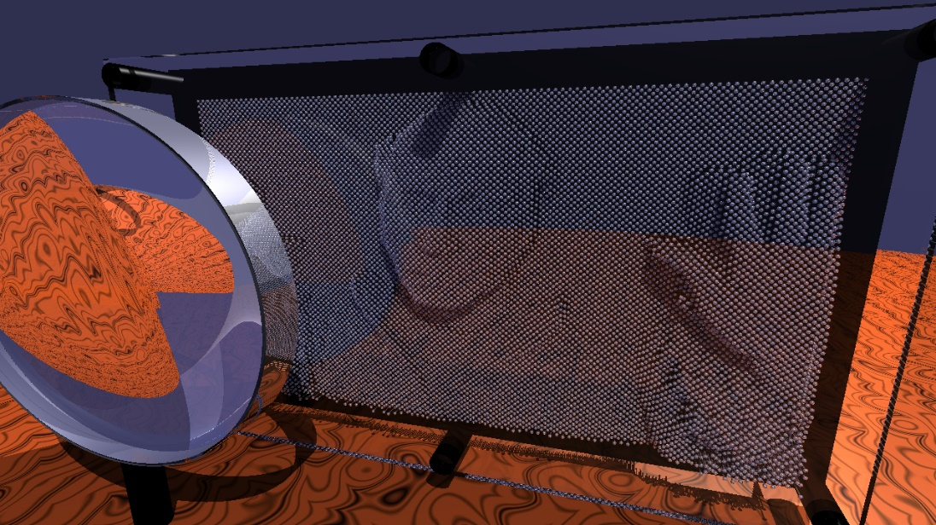


Demo Scenario – Animation Rendering
Scene Files
Ray Tracer
Image File

Slide 9
Analyzing Animation Process Requirements
Analyzing CPU Requirements
Analyzing Memory Requirements

Slide 10
Azure Batch Client API

Slide 11
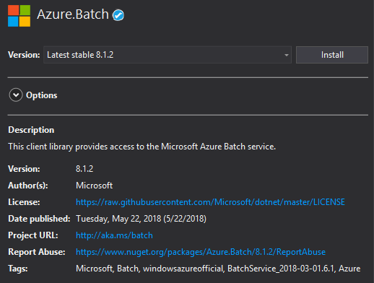
Azure.Batch NuGet Package
.NET Client Library
Wrapper around REST API
Code samples available

Slide 12
Initializing BatchClient
var cred = new BatchSharedKeyCredentials (batchAccountUrl, batchAccountName, batchAccountKey);
var batchClient = BatchClient.Open(cred);
Authentication requires:
Batch account URL
Batch account name
Primary or secondary batch account key

Slide 13
BatchClient Operations
PoolOperations
JobOperations
CreatePool
DeletePool
EnableAutoScale
ListComputeNodes
CreateJob
AddTask
GetJobTaskCounts
GetAllLifetimeStatistics

Slide 14
Creating a Pool
var pool = m_BatchClient.PoolOperations.CreatePool(poolId: poolId, virtualMachineSize: "standard_d1_v2", targetDedicatedComputeNodes: 1, virtualMachineConfiguration: new VirtualMachineConfiguration( skuAndImage.Image, skuAndImage.Sku.Id)); await pool.CommitAsync();

Slide 15
Creating Batch Workloads

Slide 16







Creating Batch Workloads
Batch Account
Storage Account
Pool
Input Files
Nodes
Output Files
Application
Job
Animation
Creator Console
Package
Tasks
Create
Pool
Upload Resource Files
Create
Job
Create Tasks
Monitor Progress
Download Output Files

Slide 17
Create Pool
// Create the pool definition var pool = m_BatchClient.PoolOperations.CreatePool(poolId: poolId, virtualMachineSize: "standard_d1_v2", targetDedicatedComputeNodes: 1, virtualMachineConfiguration: new VirtualMachineConfiguration(skuAndImage.Image, skuAndImage.Sku.Id)); // Specify additional options pool.MaxTasksPerComputeNode = 1; pool.TaskSchedulingPolicy = new TaskSchedulingPolicy(ComputeNodeFillType.Spread); // Specify any application references pool.ApplicationPackageReferences = new List<ApplicationPackageReference> { new ApplicationPackageReference{ ApplicationId = "Polyray", Version="1" } }; // Commit the changes await pool.CommitAsync();
Specify machine size and configuration and additional options
Add any required application definitions
Changes are committed by calling Commit awaiting CommitAsync

Slide 18
Create Resource Files
// Get a reference to the storage blob hosting the file CloudBlockBlob blob = m_BlobContainer.GetBlockBlobReference(blobName); // Define a shared access policy for accessing the blob SharedAccessBlobPolicy sasConstraints = new SharedAccessBlobPolicy { SharedAccessExpiryTime = DateTime.UtcNow.AddHours(24), Permissions = SharedAccessBlobPermissions.Read }; // Create the shared access signature string sasBlobToken = blob.GetSharedAccessSignature(sasConstraints); // Create the URI for accessing the blob using the shared access signature string blobSasUri = String.Format("{0}{1}", blob.Uri, sasBlobToken); // Create the resource file object specifying the URI and file name var resourceFile = ResourceFile.FromUrl(blobSasUri, blobName);
Create a shared access signature for accessing the blob
Be aware of the expiration time of the access policy

Slide 19
Create Job
// Create the job definition CloudJob job = m_BatchClient.JobOperations.CreateJob(); job.Id = jobId; // Specify the pool job.PoolInformation = new PoolInformation { PoolId = poolId }; // Set job to completed state when all tasks are complete job.OnAllTasksComplete = OnAllTasksComplete.TerminateJob; // Commit the job await job.CommitAsync();
Changes are committed by calling Commit awaiting CommitAsync

Slide 20
Create Tasks
// Create the task definition CloudTask task = new CloudTask(taskId, taskCommandLine); // Specify the input file for the task task.ResourceFiles = new List<ResourceFile> { sceneFile }; // Specify output file and file upload options task.OutputFiles = new List<OutputFile> { new OutputFile(filePattern: $"{imageFileName}", destination: new OutputFileDestination(new path: taskId + $@"\{imageFileName}")), uploadOptions: new OutputFileUploadOptions(uploadCondition: OutputFileUploadCondition.TaskCompletion)) }; // Add the task to the job m_BatchClient.JobOperations.AddTask(jobId, task);
VMs are required to upload output files
List of tasks can be added as a batch operation

Slide 21
Monitor Progress
TaskCounts taskCounts = await m_BatchClient.JobOperations.GetJobTaskCountsAsync(jobId);
int numberOfActiveTasks = taskCounts.Active;
int numberOfRunningTasks = taskCounts.Running;
int numberOfCompletedTasks = taskCounts.Completed;
int numberOfSucceededTasks = taskCounts.Succeeded;
int numberOfFailedTasks = taskCounts.Failed;
Periodically poll GetJobTaskCountsAsync
Notifications can be sent when job is complete
Consider alerting on task failures

Slide 22
Batch File Conventions Library
CloudJob job = new CloudJob(acct, jobId);
JobOutputStorage jobOutputStorage = job.OutputStorage(linkedStorageAccount);
await jobOutputStorage.SaveAsync(JobOutputKind.JobOutput, "mymovie.mp4");
await jobOutputStorage.SaveAsync(JobOutputKind.JobPreview, "mymovie_preview.mp4");
Simplifies the storage and retrieval of task output data to Azure Storage
Stream data to Azure Storage while the task is still running

Slide 23
Creating Batch Workload using Batch API
Creating an Azure Batch Pool
Creating a Job
Submitting Tasks to a Job

Slide 24
Testing Batch Workload Creation
Examining Job and Task execution
Creating a 1000 frame 4K animation

Slide 25
Different workflows require different resources
Compute resources should be optimized for desired workflow
Azure Batch Client API provides programmatic access to Azure Batch
Resource Management
Runtime Operations
Summary

